Slide 1
Predicting growth conditions from omics data via machine learning
Umut Caglar UT Austin (Wilke Lab)

Slide 2
Q: Can we predict external conditions of bacteria growth by using machine learning technics?

Slide 3
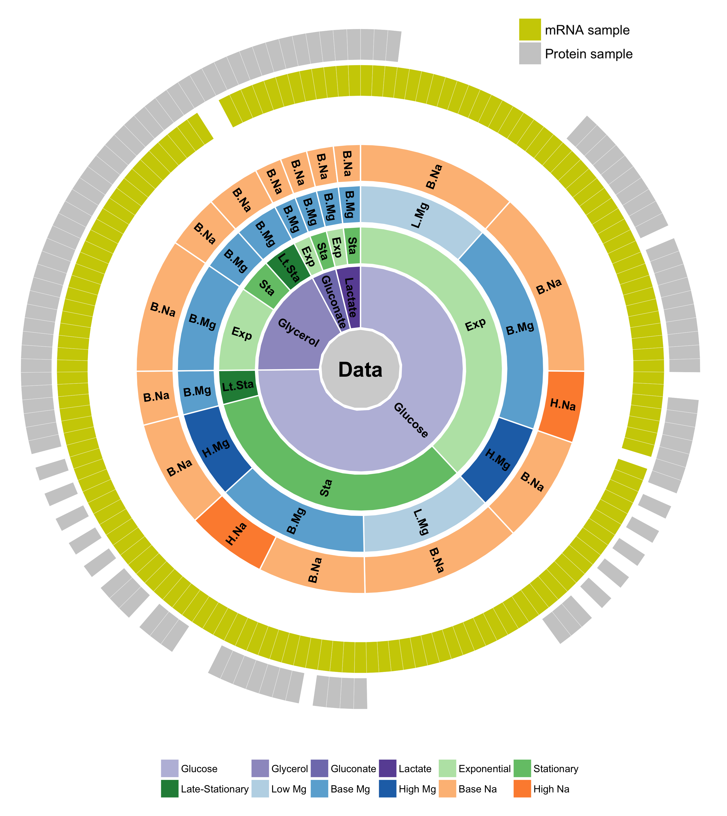
We have a large data set to learn bacterial response to external conditions

Slide 4
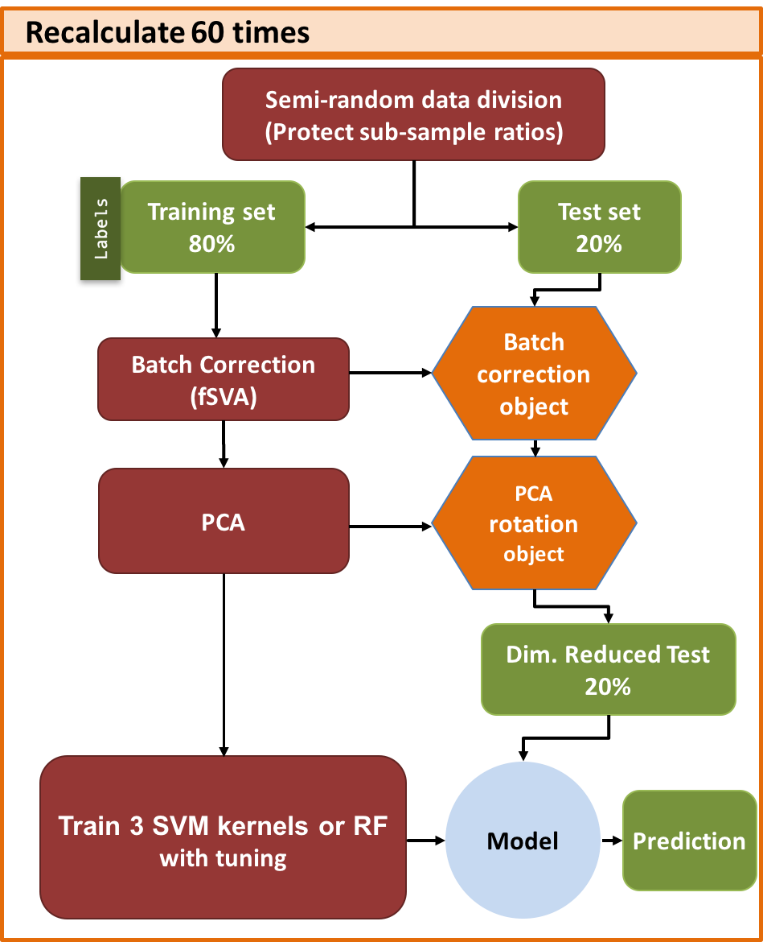
INITIAL DATA PREPERATION
DeSeq2, log transform.
SAMPLES
Labels
SVM Training with Tuning
Training set 80%
Labels
Semi-random data division
(Protect sub-sample ratios)
Training set 60%
Tune set 20%
Labels
3 SVM kernels or RF
Class weight normalization
Model
Parameter dependent prediction
Best
Model

Slide 5
INITIAL DATA PREPERATION
DeSeq2, log transform.
SAMPLES
Labels
SVM Training with Tuning
Training set 80%
Labels
Semi-random data division
(Protect sub-sample ratios)
Training set 60%
Tune set 20%
Labels
3 SVM kernels or RF
Class weight normalization
Model
Parameter dependent prediction
Best
Model

Slide 6
INITIAL DATA PREPERATION
DeSeq2, log transform.
SAMPLES
Labels
SVM Training with Tuning
Training set 80%
Labels
Semi-random data division
(Protect sub-sample ratios)
Training set 60%
Tune set 20%
Labels
3 SVM kernels or RF
Class weight normalization
Model
Parameter dependent prediction
Best
Model

Slide 7
Correct Metric is important
Pred True | A | B | C
A | 15 | 7 | 2
B | 11 | 45 | 1
C | 9 | 3 | 33
Confusion Matrix

Slide 8
Correct Metric is important
Pred True | A | B | C
A | 15 | 7 | 2
B | 11 | 45 | 1
C | 9 | 3 | 33
Confusion Matrix

Slide 9
Correct Metric is important
Pred True | A | B | C
A | 15 | 7 | 2
B | 11 | 45 | 1
C | 9 | 3 | 33
TP
FN
FP
Confusion Matrix

Slide 10
- What percent of the row “A” is on diagonal ? Precision = TP / (TP+FN)
Pred True | A | B | C
A | 15 | 7 | 2
B | 11 | 45 | 1
C | 9 | 3 | 33
TP
FN
FP
Confusion Matrix

Slide 11
- What percent of the column “A” is on diagonal ? Recall = TP / (TP+FP)
Pred True | A | B | C
A | 15 | 7 | 2
B | 11 | 45 | 1
C | 9 | 3 | 33
TP
FN
FP
Confusion Matrix

Slide 12
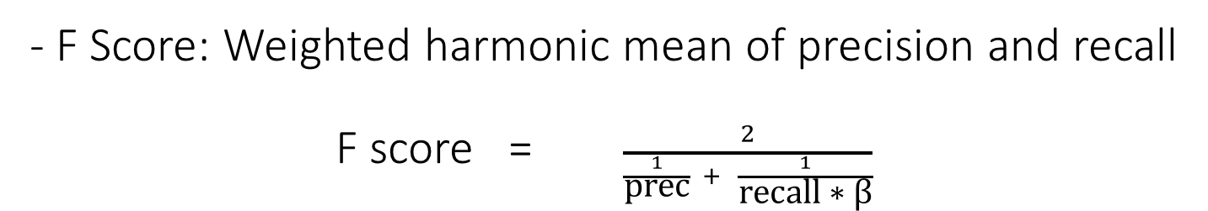
- F Score: Weighted harmonic mean of precision and recall F score = $\frac{2}{\frac{1}{\text{prec}} + \frac{1}{\text{recall}\text{ ∗ }\text{β}}}$
Pred True | A | B | C
A | 15 | 7 | 2
B | 11 | 45 | 1
C | 9 | 3 | 33
TP
FN
FP
Confusion Matrix

Slide 13
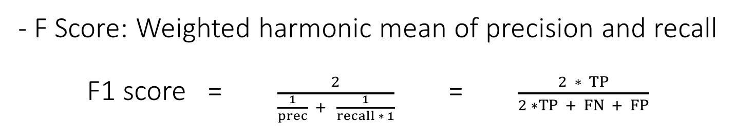
- F Score: Weighted harmonic mean of precision and recall F1 score = $\frac{2}{\frac{1}{prec} + \frac{1}{recall ∗ 1}}$ = $\frac{2 ∗ TP}{2 ∗TP + FN + FP}$
Pred True | A | B | C
A | 15 | 7 | 2
B | 11 | 45 | 1
C | 9 | 3 | 33
TP
FN
FP
Confusion Matrix

Slide 14
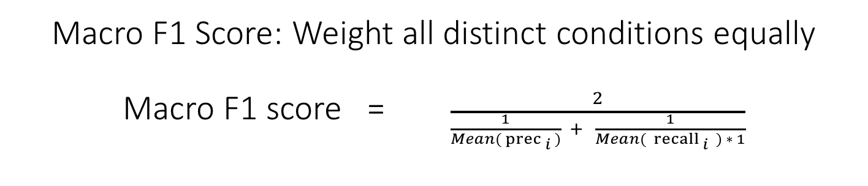
Macro F1 Score: Weight all distinct conditions equally Macro F1 score = $\frac{2}{\frac{1}{Mean({ prec}_{ i })} + \frac{1}{Mean({ recall}_{ i } ) ∗ 1}}$
Pred True | A | B | C
A | 15 | 7 | 2
B | 11 | 45 | 1
C | 9 | 3 | 33
TP
FN
FP
Confusion Matrix

Slide 15
mRNA Results - Radial kernel

Slide 16
Protein Results - Sigmoidal kernel

Slide 17
Q: Can we predict external conditions of bacteria growth by using machine learning technics?
A:
Yes, and
it does not depend much on model, it depend on data type, and number of samples

Slide 18
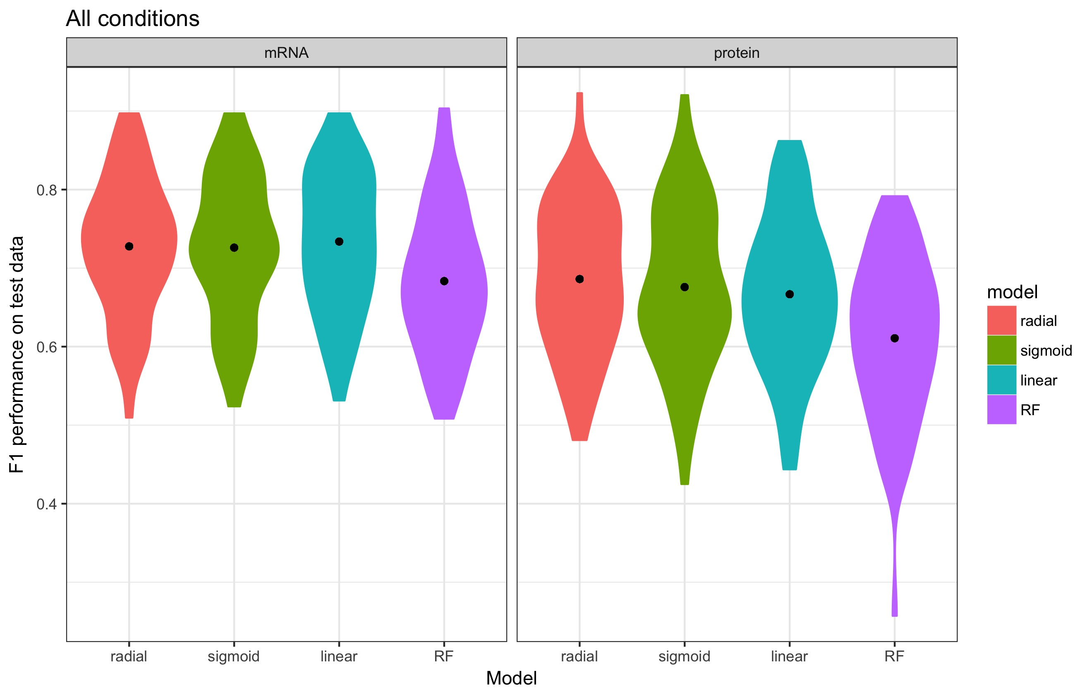
Results are comparable but mRNA have more samples

Slide 19
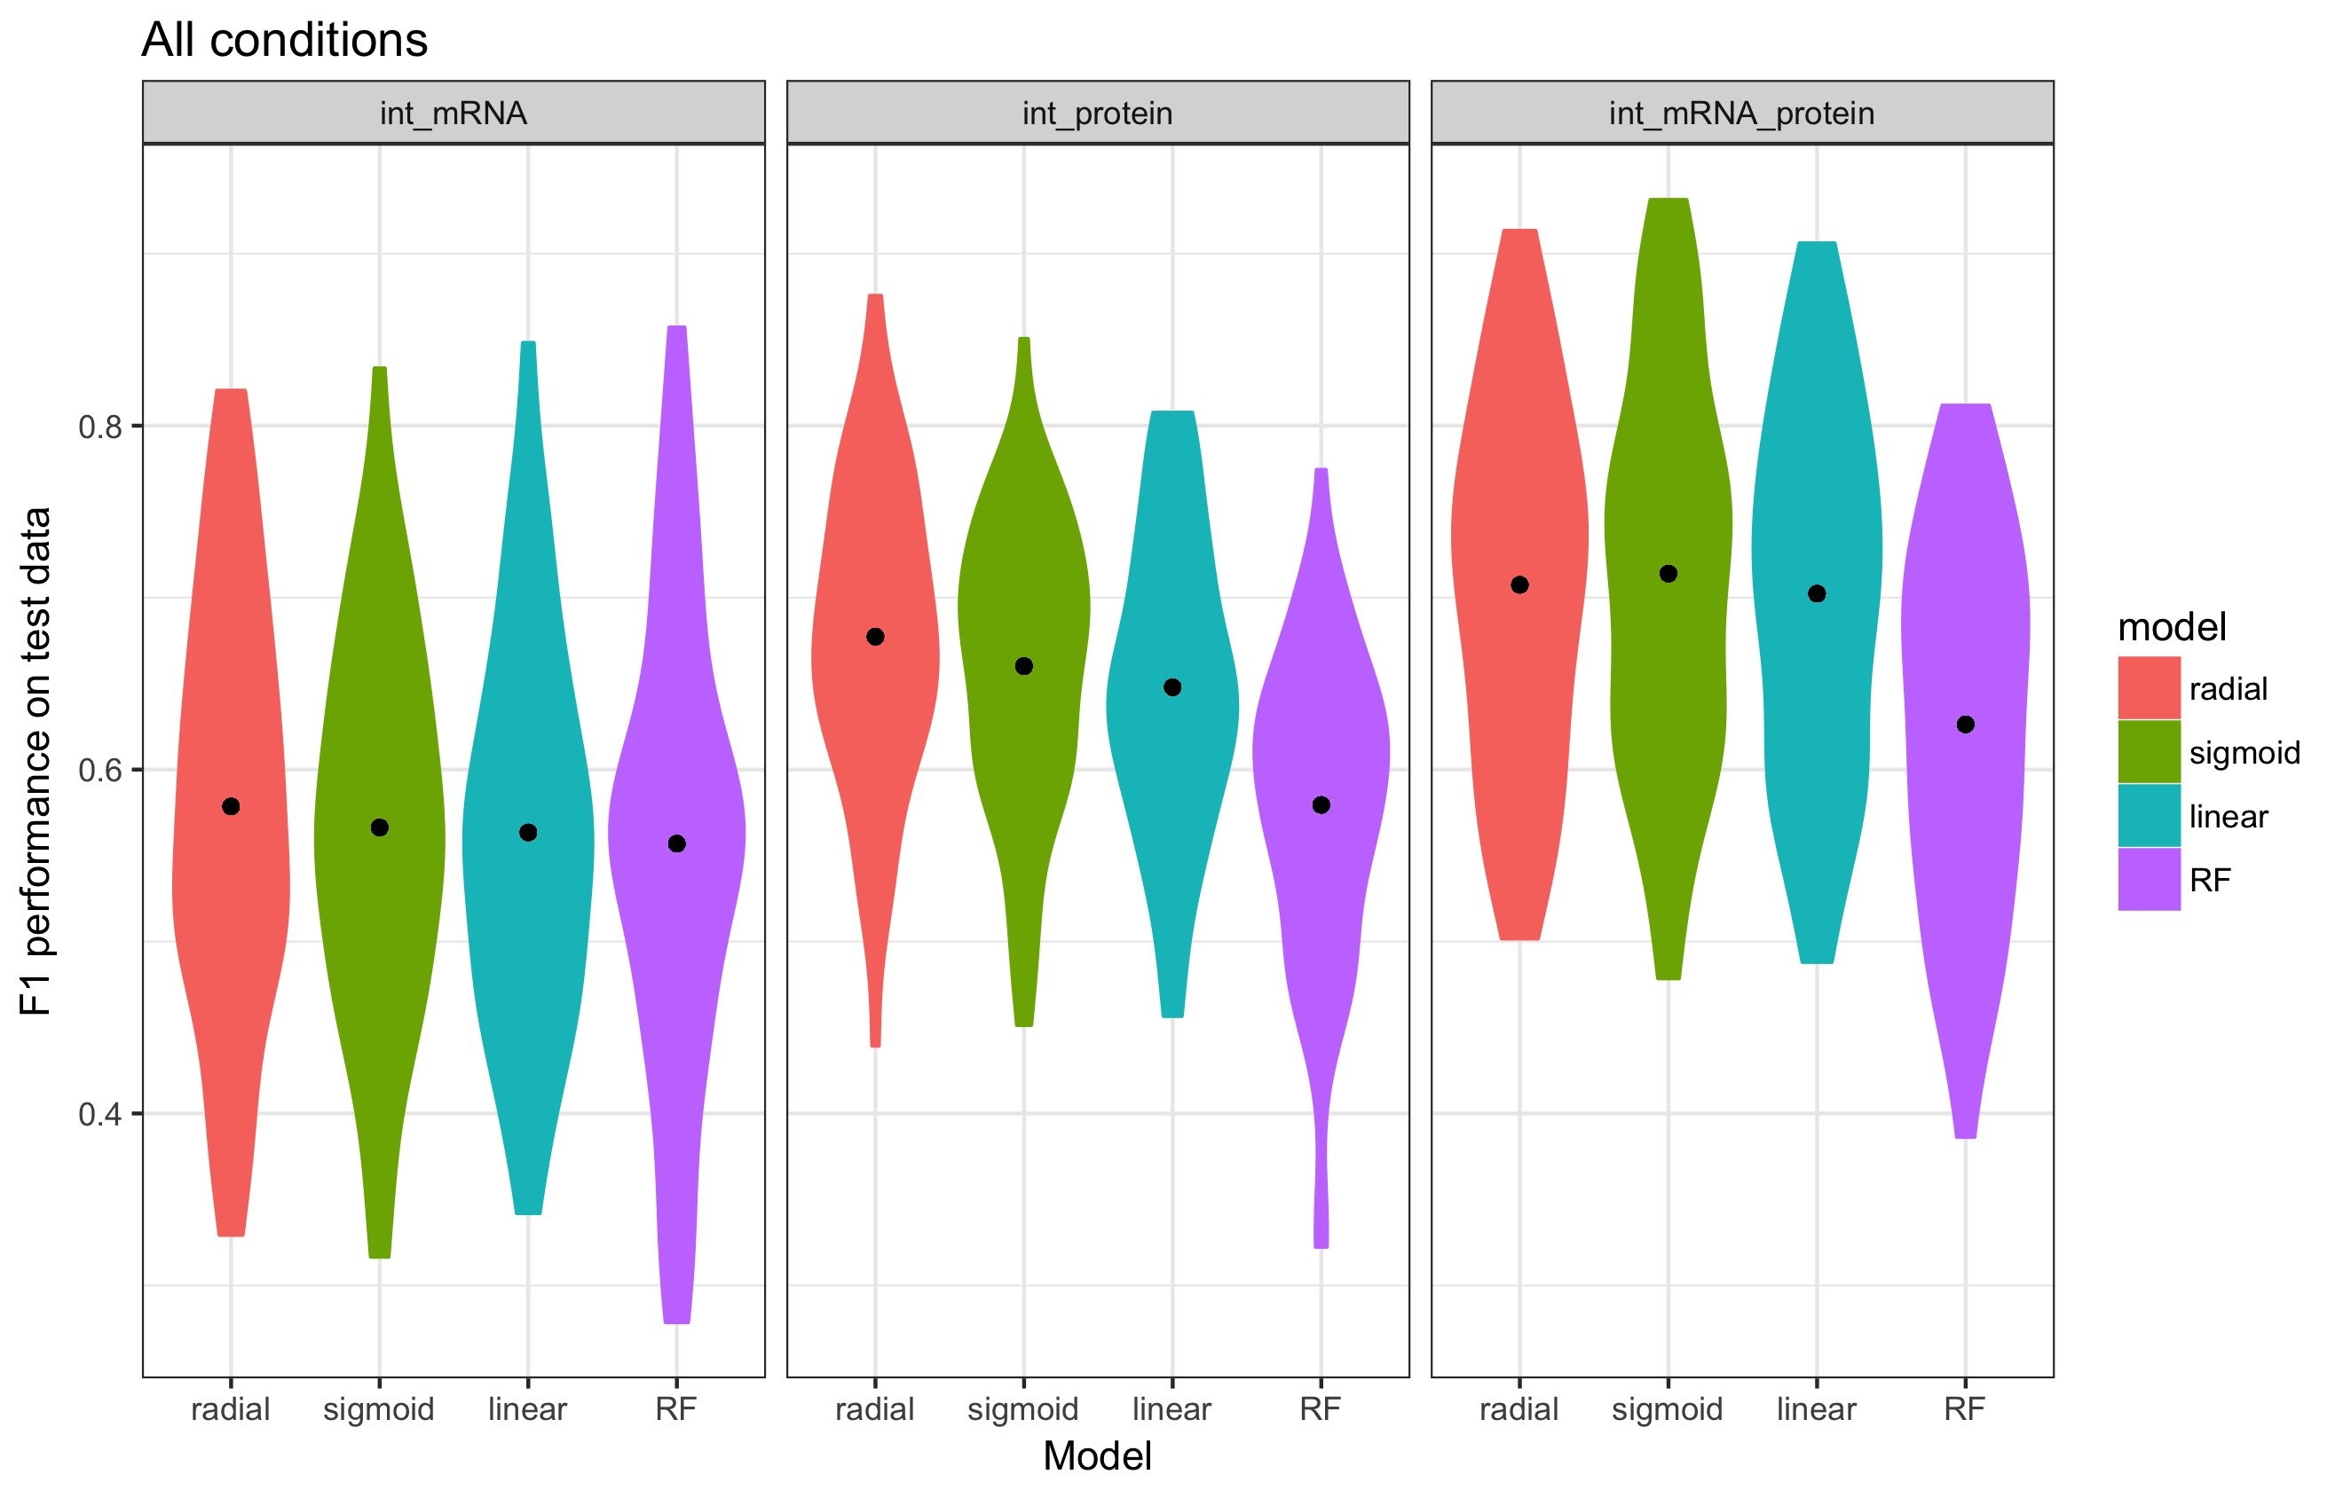
Combined > Protein > mRNA

Slide 20
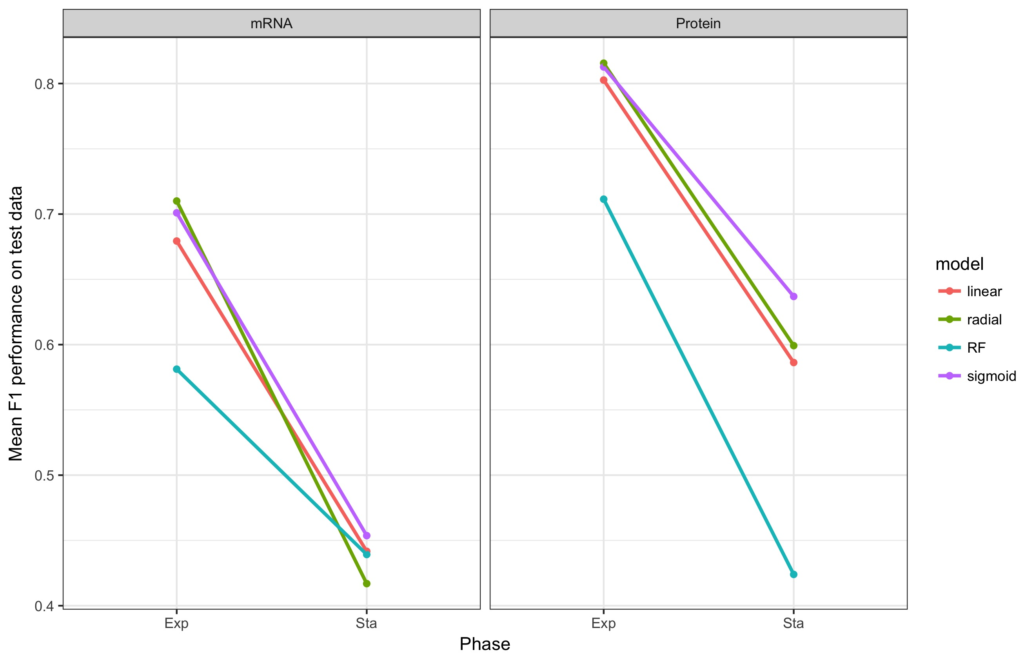
Predictability decreases between phases

Slide 21
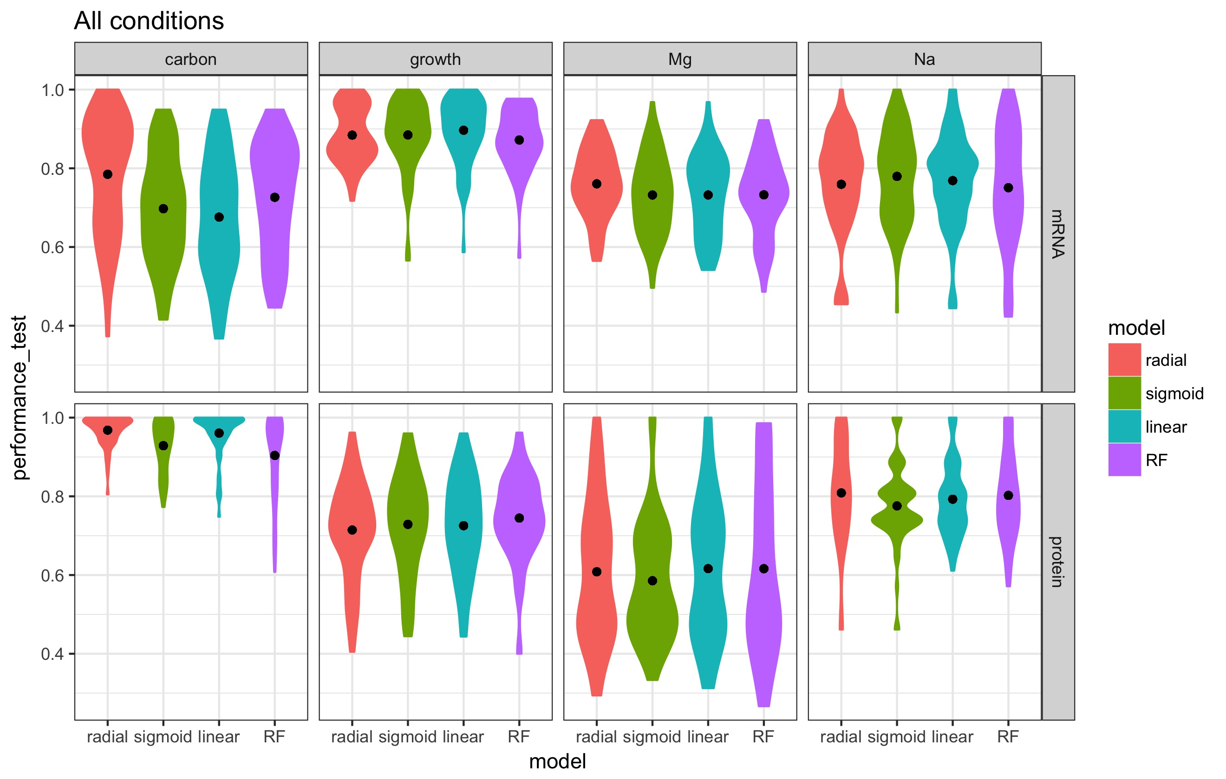
Predictability for individual conditions vary. Results are consistent with clustering of samples

Slide 22
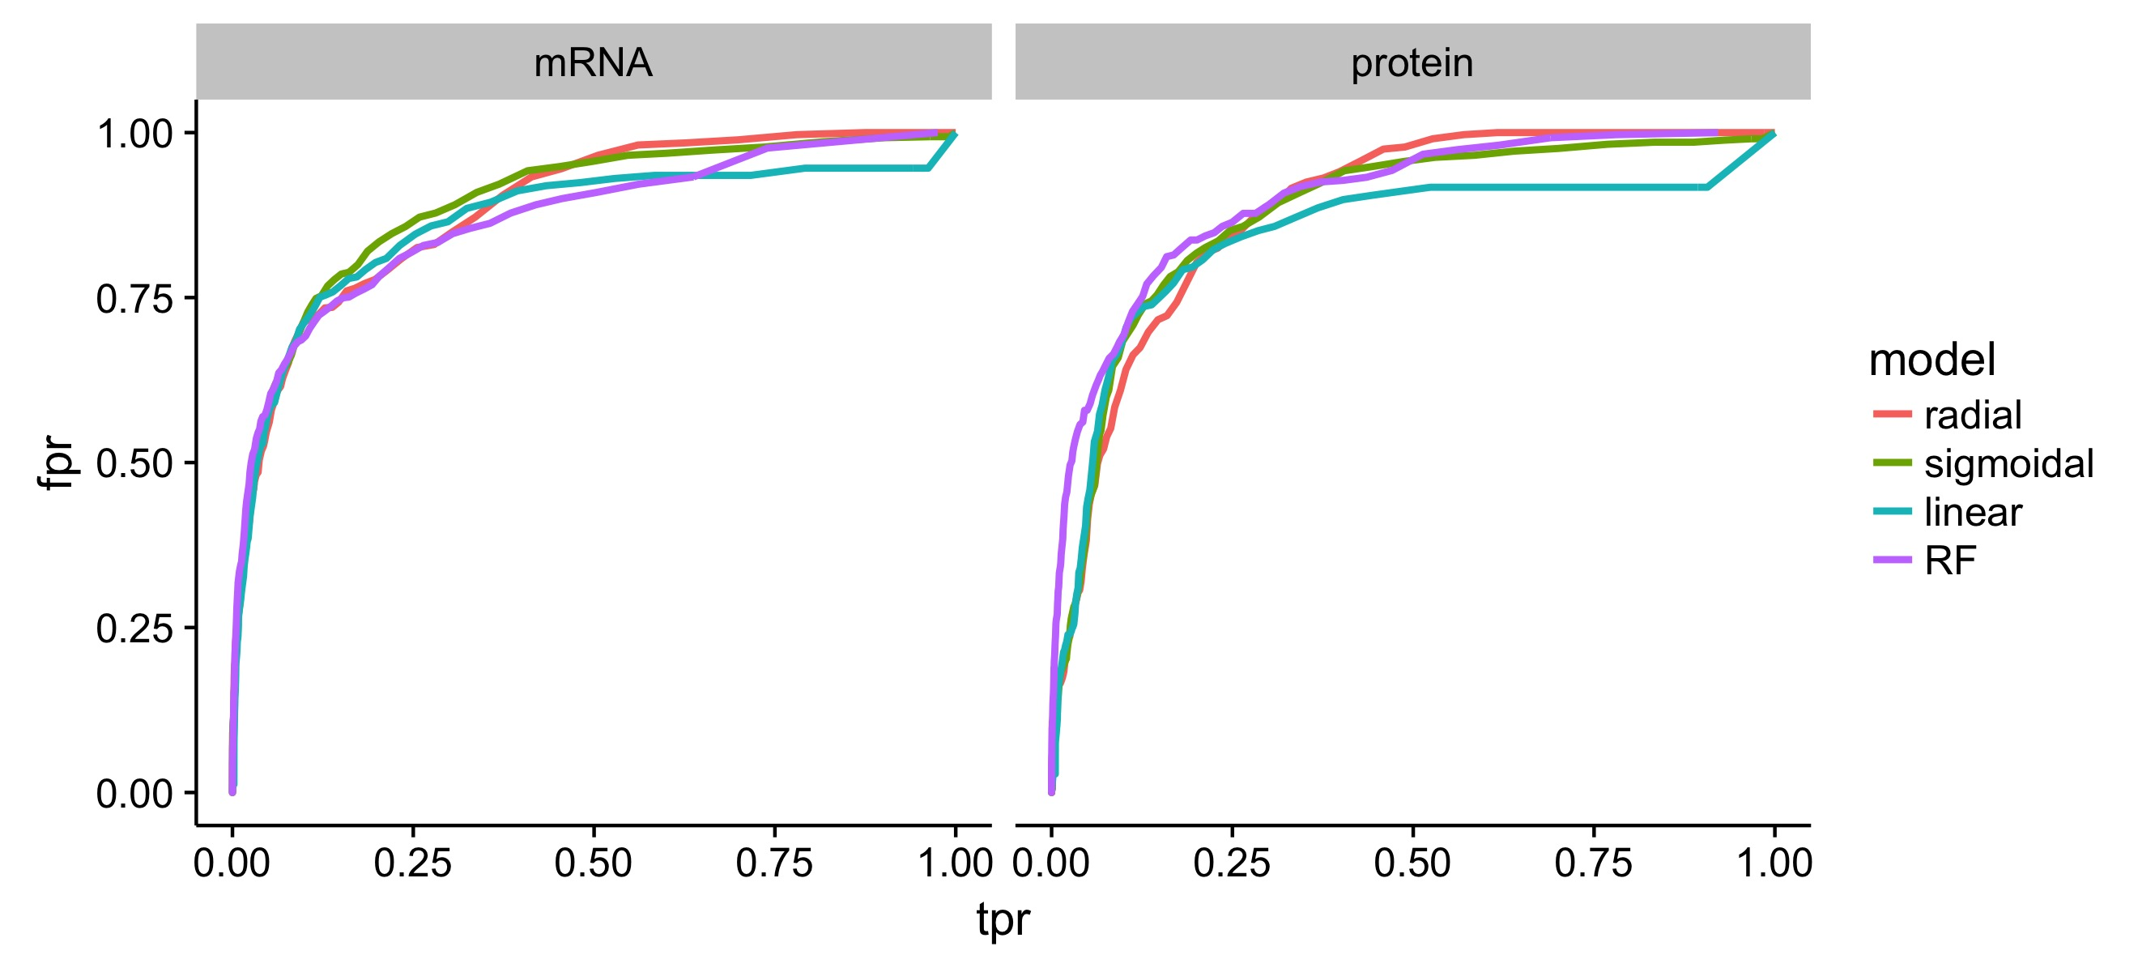
ROC Curves gives similar results for different models

Slide 23
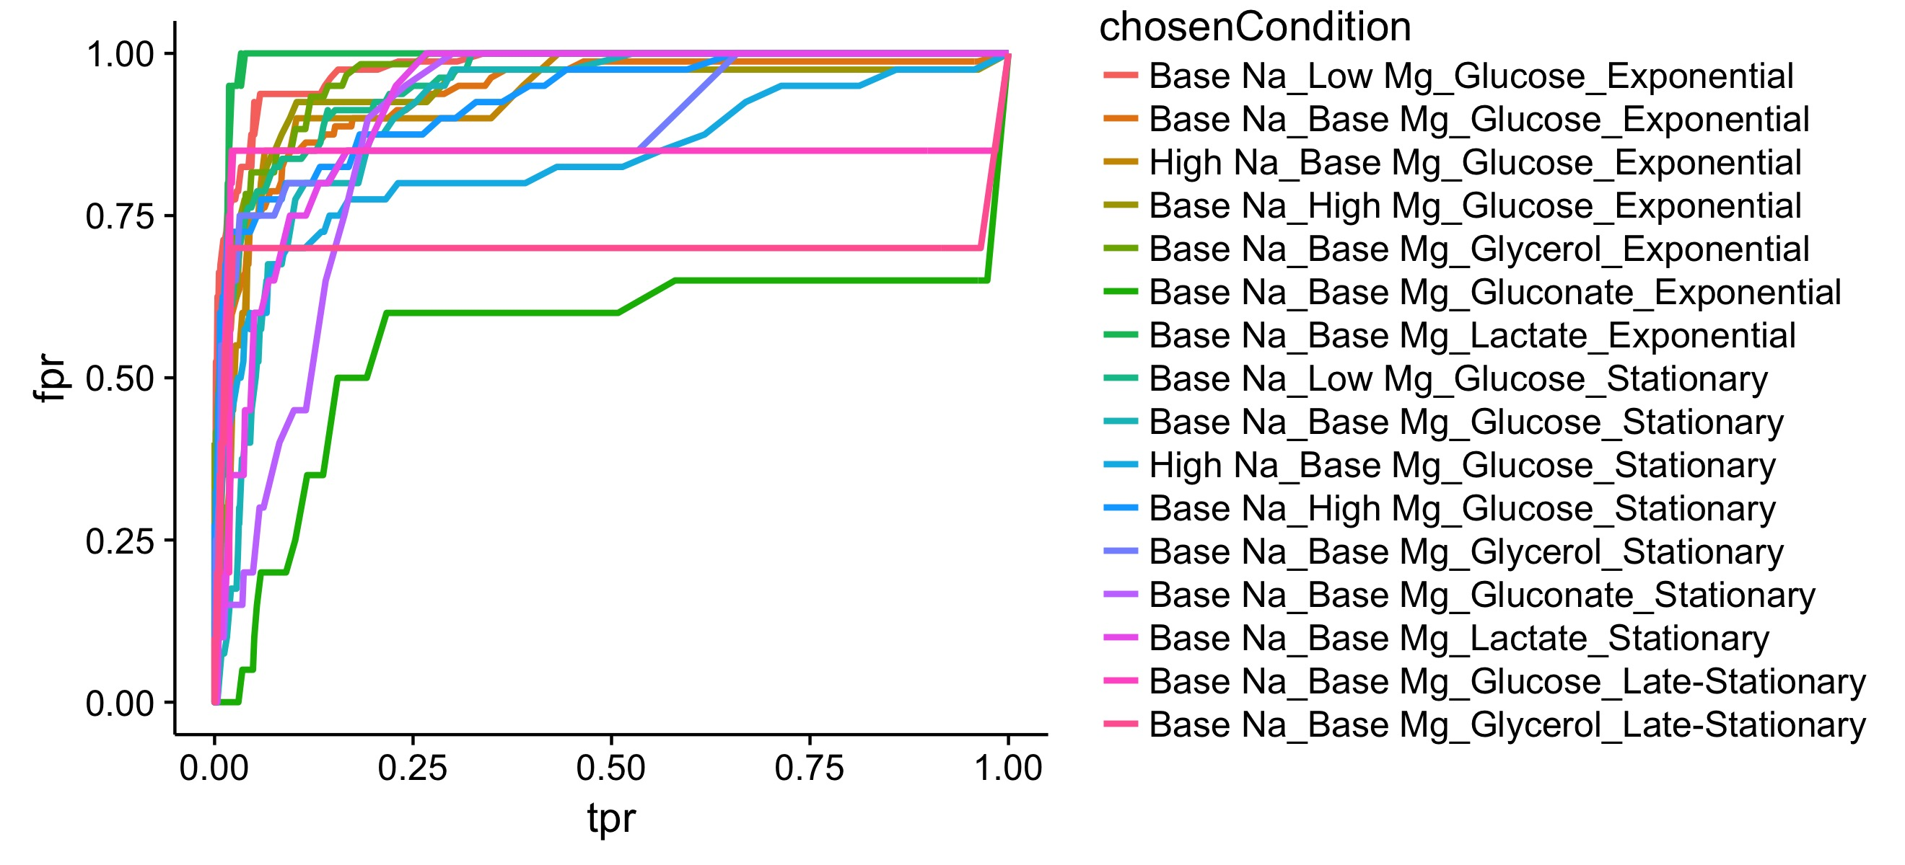
How do I get the curves

Slide 24
Single Cell Virology Image Processing Automation Challenges

Slide 25
The brightened images are necessary to distinct problematic wells

Slide 26
SNAILS
An image processing method that helped me to locate the wells

Slide 27
A project I did long ago.

Slide 28
I project I did long ago.
1
Pull of nodes are proportional to distance
Gradient related force is bigger when gradient is bigger
I started it from broader frame
F1 First node pull
F2 Second node pull
Gradient related friction
2

Slide 29
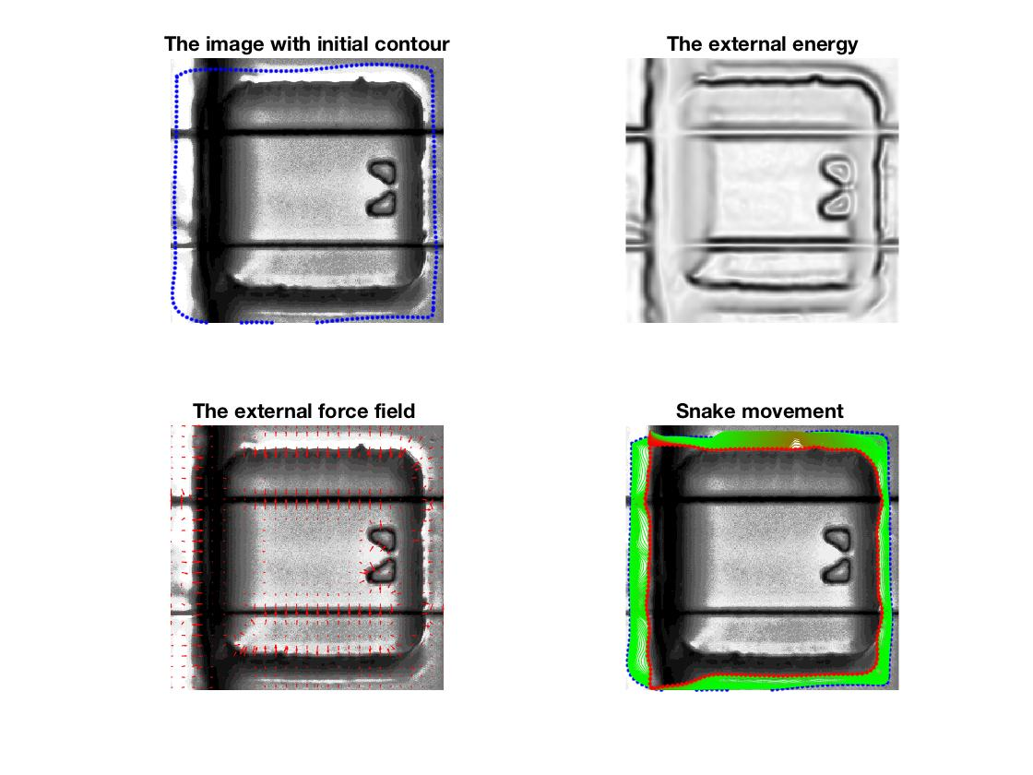
It helps me to locate the boundries of wells

Slide 30
Next step is to locate holders

Slide 31
Finding the Holders Might Not Be Easy -1

Slide 32
Finding the Holders Might Not Be Easy -2

Slide 33
Finding the Holders Might Not Be Easy -3

